Slide 1
Internet of Things UNIT IV IoT Systems, Network and Protocols
Prepared By
Mrs.Mital Kadu
Assistant Professor
Artificial Intelligence and Data Science
DYPIEMR, Pune

Slide 2
Syllabus
Study of RF
Wireless Sensors
Wireless networks
Wireless Sensor Networking (WSN)
Cellular Machine-to- Machine (M2M) application networks
Computer Connected to Internet
Network Devices
Device configuration and management
Exchange information in real time without human intervention;
IoT Protocols

Slide 3
Study of RF
Radio Frequency Identification (RFID)
It is very simple, cost effective way of item identification
RFID tag is simplified, low cost, disposable contactless smart card.
RFID tag include a chip that store a static number (ID) and attributes of the tagged object and an antenna that enables the chip to transmit the store number to a reader
Notes:
https://www.youtube.com/watch?v=qUTssrhayNY

Slide 4
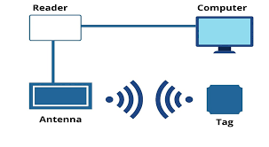
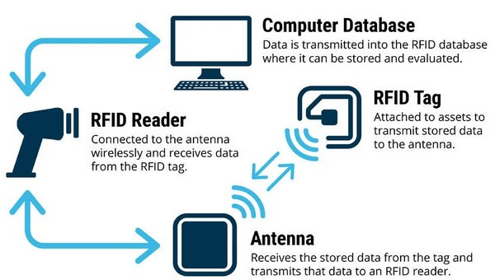
Study of RF

Slide 5
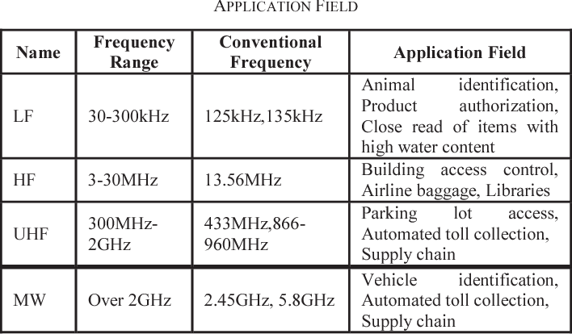
Study of RF
RFID frequency range:
RFID Tag operates in different frequencies with different advantages ( low frequency, high frequency, ultra high frequency, microwave)

Slide 6
Study of RF
Reader functions:
Remotely power tags
Establish a bidirectional data link
Inventory tags, filter results
Communicate with networked server(s)
Can read 100-300 tags per second

Slide 7
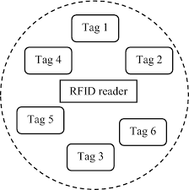
Study of RF
RFID Anti-Collision Protocols:
Collision due to simultaneous tag responses is one of the key issues in RFID systems.
Tag collision results in wastage of bandwidth, energy and increases identification delays.
RFID readers must use an anti-collision protocol to minimize collisions
hence helps to reduce identification delays.

Slide 8
Study of RF
RFID advantages over bar-codes
No line of sight required for reading
Multiple items can be read with a single scan
Each tag can carry a lot of data (read/write)
Individual items identified and not just the category
Passive tags have a virtually unlimited lifetime
Active tags can be read from great distances
Can be combined with barcode technology

Slide 9
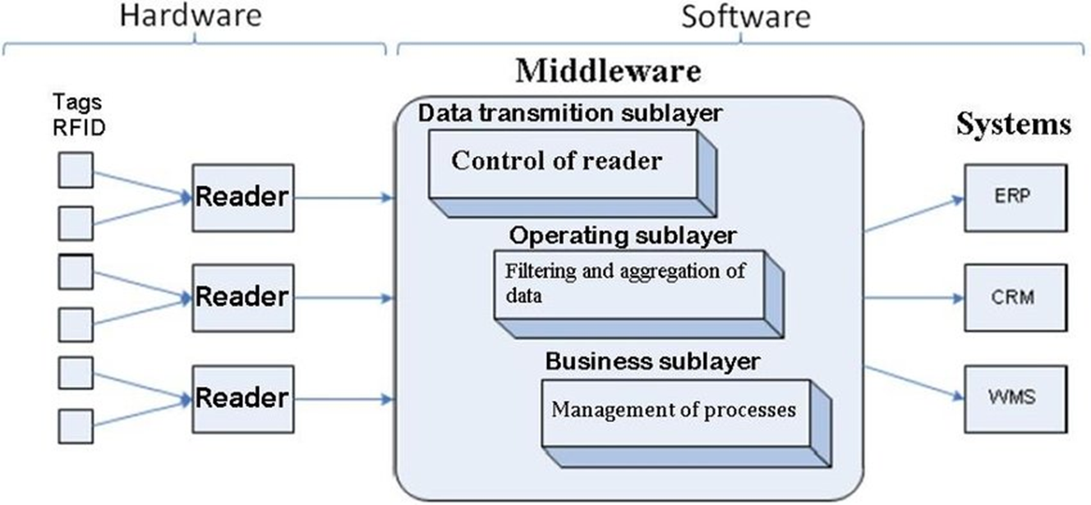
Study of RF
RFID Middleware must provide:
B2B (Business to Business) integration features like partner profile management
Support for B2B transport protocols
Integration with a partner's data over communications

Slide 10
Study of RF
RFID Middleware benefits
Minimized network traffic through intelligent filtering
Lower reader-management costs through centrally coordinated readers
Immediate visibility to RFID data through routing, filtering and track-and-trace tools
Minimized on-going integration costs through standard APIs and prepackaged application integration tools
Well-architected RFID middleware can enable more strategic opportunities that a go way beyond these initial, rather obvious benefits

Slide 11
Study of RF
Weaknesses of RFID
Lack of industry and application standards
High cost per unit and high RFID system integration costs
Weak market understanding of the benefits of RFID technology

Slide 12
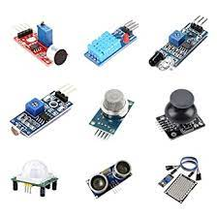
Wireless Sensor
Allows to collect information about surrounding environments over extended periods with little manual effort

Slide 13
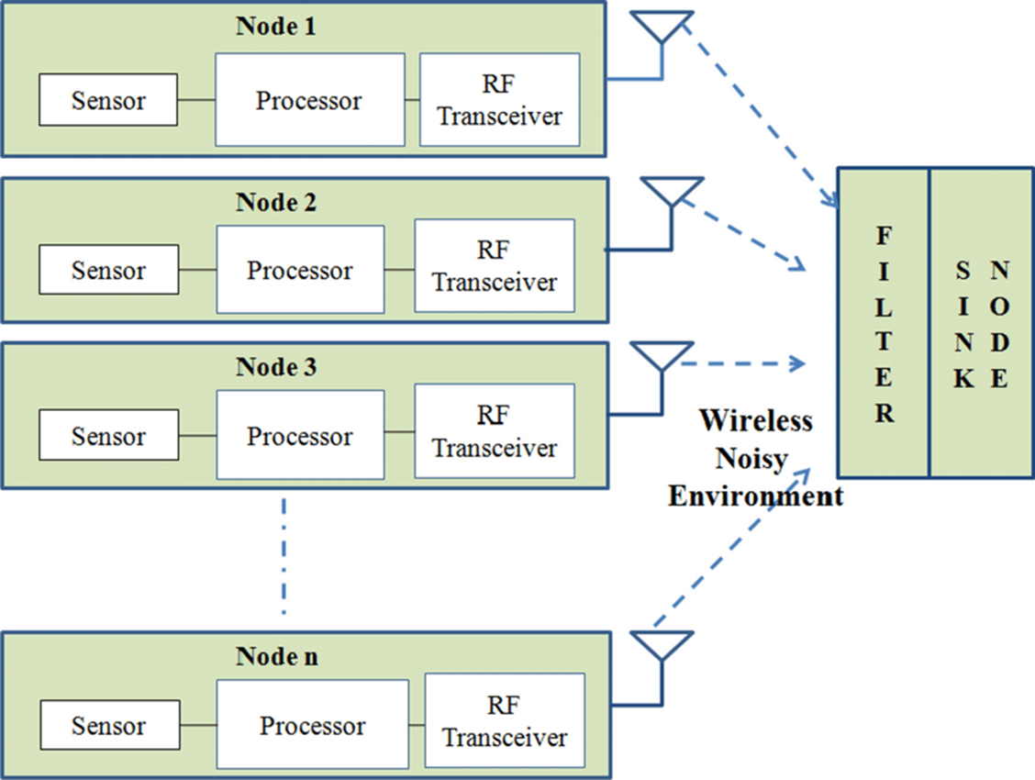
Wireless Sensor
Used in :
environmental science,
medical sciences,
telecommunications,
education services,
agriculture,
surveillance,
military services

Slide 14
Wireless Sensor
A device that can gather sensory information and detect changes in local environments
Designed to measure specific parameters about their physical surroundings and produce outputs, often electrical signals, for further processing
These parameters include many different types of stimulation, including air temperature, lighting levels, movements, and liquid leakages.
Some examples of wireless sensors Wireless proximity sensors- detect the presence or absence of different types of objects
Notes:
https://www.youtube.com/watch?v=xAiSuQK22IM

Slide 15
Wireless Sensor
Wireless movement sensor- detect certain types of motion, including acceleration and tilt
Wireless liquid sensors- detect the presence of liquids, such as water or fuel
Wireless air sensors- used to assess air quality, including temperature, humidity, and the presence of harmful gases

Slide 16
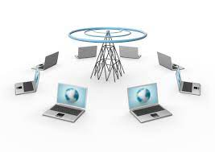
Wireless Networks(WLAN)
A wireless local area network (WLAN) is a wireless distribution method for two or more devices.
WLANs use high-frequency radio waves and often include an access point to the Internet.
A WLAN allows users to move around the coverage area, often a home or small office, while maintaining a network connection
Notes:
https://www.youtube.com/watch?v=9y9RKA4vAcw

Slide 17
Wireless Sensor Networking (WSN)
WSN is an infrastructure-less wireless network
Deployed in a large number of wireless sensors in an ad-hoc manner
Used to monitor the system, physical or environmental conditions.
Sensor nodes are used in WSN with the onboard processor that manages and monitors the environment in a particular area.

Slide 18
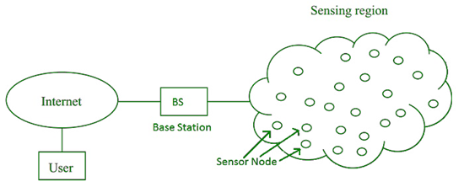
Wireless Sensor Networking (WSN)
They are connected to the Base Station which acts as a processing unit in the WSN System.
Base Station in a WSN System is connected through the Internet to share data.
WSN can be used for processing, analysis, storage, and mining of the data.

Slide 19
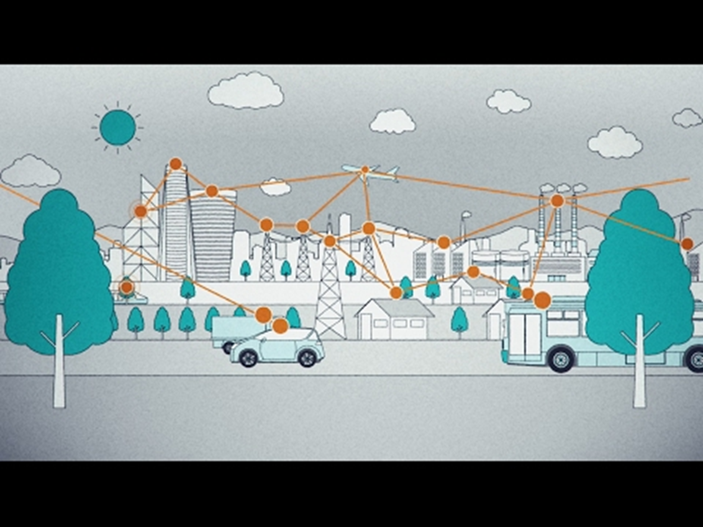
Wireless Sensor Networking (WSN)
Applications of WSN:
Internet of Things (IOT)
Surveillance and Monitoring for security, threat detection
Environmental temperature, humidity, and air pressure
Noise Level of the surrounding
Medical applications like patient monitoring
Agriculture
Landslide Detection

Slide 20
Wireless Sensor Networking (WSN)
Challenges of WSN:
Quality of Service
Security Issue
Energy Efficiency
Network Throughput
Performance
Ability to cope with node failure
Cross layer optimization
Scalability to large scale of deployment

Slide 21
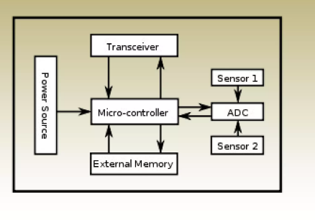
Wireless Sensor Networking (WSN)
Components of WSN:
Sensors:
used for data acquisition
Sensor signals are converted into electrical signals.
Radio Nodes:
used to receive the data produced by the Sensors
and sends it to the WLAN access point
It consists of
a microcontroller,
transceiver,
external memory, and
power source.

Slide 22
Wireless Sensor Networking (WSN)
WLAN Access Point:
It receives the data which is sent by the Radio nodes wirelessly, generally through the internet.
Evaluation Software:
The data received by the WLAN Access Point is processed by a software called as Evaluation Software
for presenting the report to the users for further processing of the data
processing, analysis, storage, and mining of the data.

Slide 23
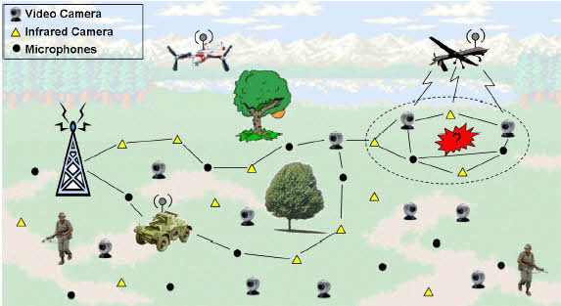
Types of WSN- Terrestrial Wireless Sensor Networks
Terrestrial WSNs are used for communicating base stations efficiently, and comprise thousands of wireless sensor nodes deployed either in an unstructured (ad hoc) or structured (Pre-planned) manner.
The terrestrial sensor networks are designed to operate on the land. It needs air as communication channel for communication

Slide 24
Types of WSN- Terrestrial Wireless Sensor Networks
In an unstructured mode (ad hoc), the sensor nodes are randomly distributed within the target area that’s dropped from a set plane.
In WSNs, the battery power is limited, however, the battery is provided with solar cells as a secondary power source.
The conservation of energy of the WSNs gets by using low duty cycle operations, optimal routing, minimizing delays, and so on.

Slide 25
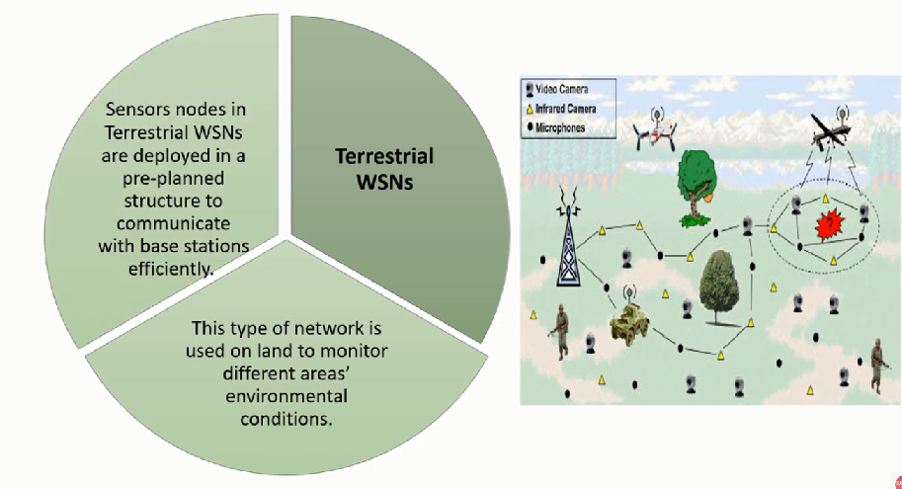
Types of WSN- Terrestrial Wireless Sensor Networks

Slide 26
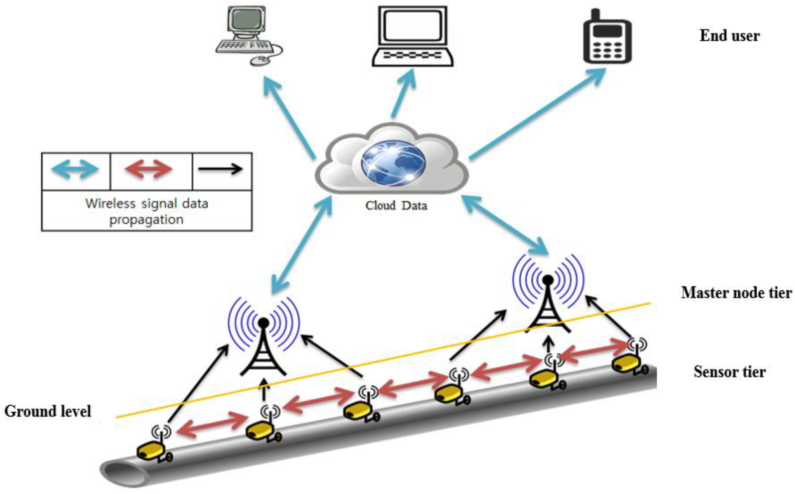
Types of WSN- Underground Wireless Sensor Networks
In terms of deployment, maintenance, equipment cost considerations, and careful planning, underground wireless sensor networks are more expensive than terrestrial WSNs.
The Underground Wireless sensor networks UWSNs comprises several sensory nodes that are hidden in the ground to observe underground conditions.

Slide 27
Types of WSN- Underground Wireless Sensor Networks
Additional sink nodes are located above the bottom to transfer information from the sensor nodes to the base station, These underground WSNs deployed into the ground are difficult to recharge.
The sensor battery nodes equipped with limited battery power are also difficult to recharge. Additionally, the underground environment makes wireless communication a challenge because of the high attenuation and signal loss level.

Slide 28
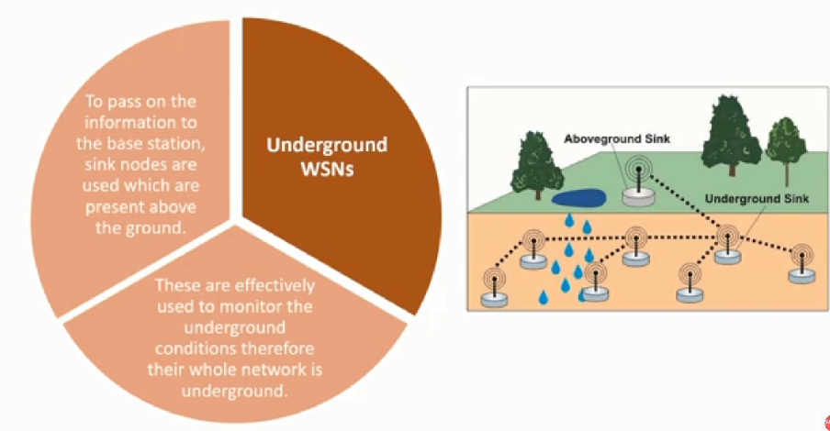
Types of WSN- Underground Wireless Sensor Networks

Slide 29
Types of WSN- Underwater Wireless Sensor Networks
About more than 70% of the earth’s planet is occupied with water.
These networks contain several sensor nodes and vehicles deployed underwater.
Autonomous underwater devices and vehicles are used to collect data from these sensor nodes.

Slide 30
Types of WSN- Underwater Wireless Sensor Networks
A challenge of underwater communication may be a long propagation delay, and bandwidth and sensor failures.
Underwater, WSNs are equipped with a limited battery that can’t be recharged or replaced.
The difficulty of energy conservation for underwater WSNs involves the development of underwater communication and networking techniques.

Slide 31
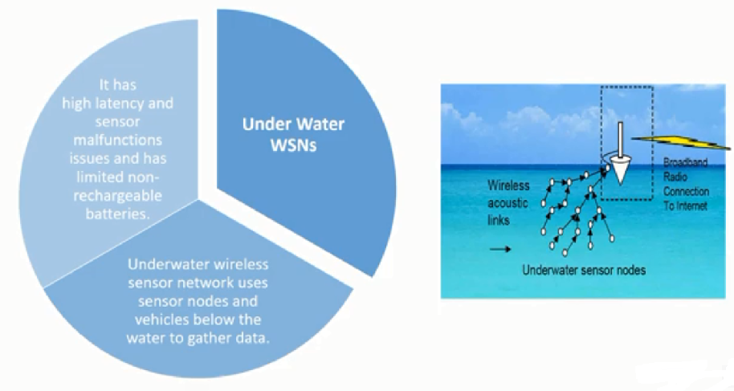
Types of WSN- Underwater Wireless Sensor Networks

Slide 32
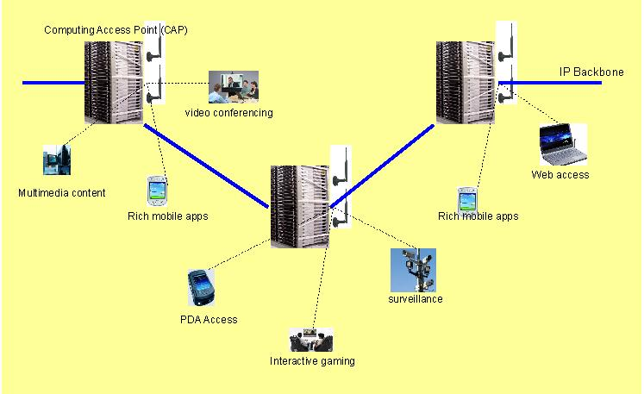
Types of WSN- Multimedia Wireless Sensor Networks
Multimedia wireless sensor networks are proposed to enable tracking and monitoring of events in the sort of multimedia, like video, imaging, and audio.
These networks contain low-cost sensor nodes equipped with cameras and microphones. These sensory nodes of Multimedia WSNs are interconnected together over a wireless connection for data retrieval, data compression, and correlation.
The challenges with the Multimedia WSNs include high bandwidth requirements, high energy consumption, processing, and compressing techniques. Additionally, multimedia contents need high bandwidth for the content to be delivered properly and easily.

Slide 33
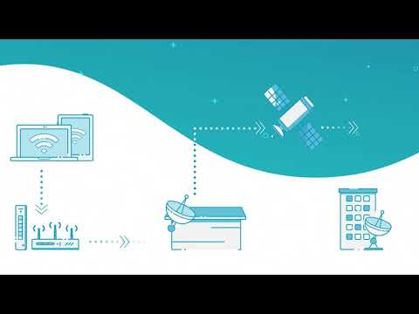
Types of WSN- Multimedia Wireless Sensor Networks

Slide 34
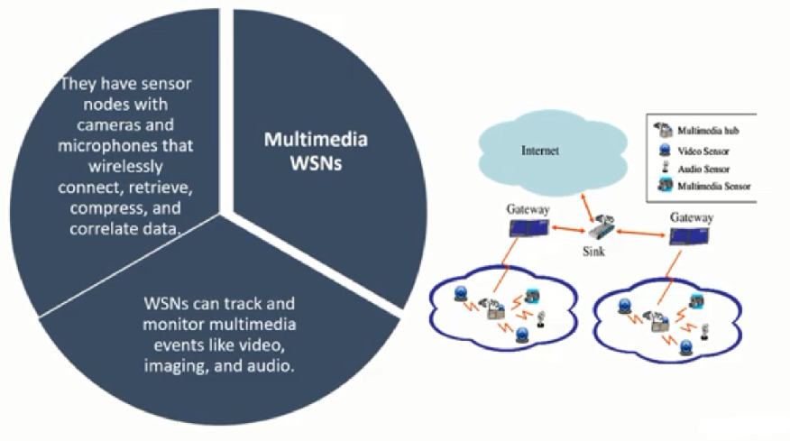
Types of WSN- Multimedia Wireless Sensor Networks

Slide 35
What is Cellular M2M?
Cellular M2M is a mode of communication, in which cellular networks transmit data over a long distance. Cellular networks permit machines to exchange data with other machines, services, and applications running in the cloud software. Further, M2M stands for machine-to-machine communication, without any human interaction or interference. Some examples of M2M are serial connection, wireless communication in IoT (Internet of Things), and power line connection (PLC).
Machine-to-machine communications can be set up over WAN (Wide Area Network) and facilitated by cellular networks like mobiles. Apart from this, the three key components that maintain the flow of M2M communication are sensors that gather and transmit data, a wireless network for data exchange, and internet-connected servers for data analysis and action.
Furthermore, cellular M2M is considered one of the fastest-growing technologies in the market, as this has the power to connect millions of devices under a single network system. According to a report published by Research Dive, the global cellular M2M market is anticipated to flourish at a CAGR of 20.5% during the 2020-2027 timeframe.

Slide 36
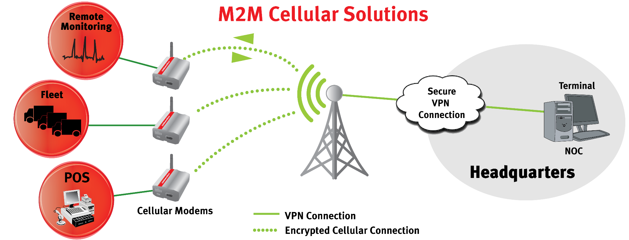
What is Cellular M2M?

Slide 37
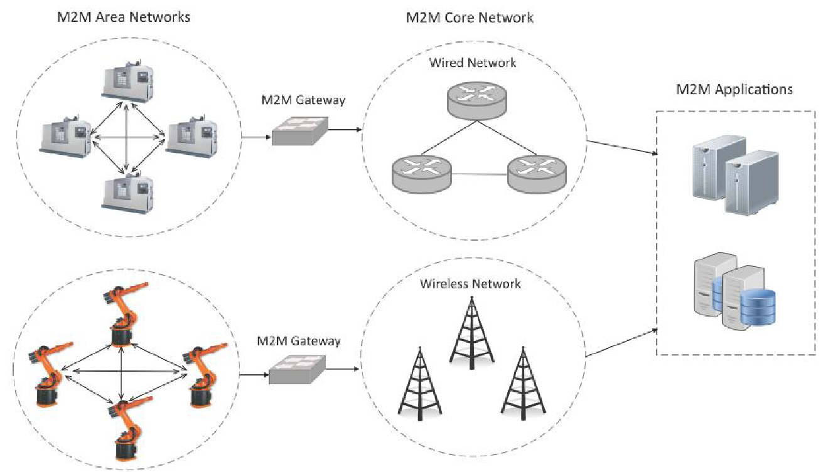
Cellular Machine-to- Machine (M2M) application networks
Architecture and components of M2M:
Machine-to-Machine (M2M) refers to networking of machines (or devices)
for the purpose of
remote monitoring
control and data exchange
Notes:
https://www.youtube.com/watch?v=MZsQ1WihonQ

Slide 38
Cellular Machine-to- Machine (M2M) application networks
An M2M area network comprises of machines (or M2M nodes) which have embedded hardware modules for sensing, actuation and communication.
Various communication protocols can be used for M2M local area networks such as ZigBee, Bluetooh, ModBus, M-Bus, Wirless M-Bus, Power Line Communication (PLC), 6LoWPAN, IEEE 802.15.4, etc.

Slide 39
Cellular Machine-to- Machine (M2M) application networks
The communication network provides connectivity to remote M2M area networks.
The communication network can use either wired or wireless networks (IPbased).
While the M2M area networks use either proprietary or non-IP based communication protocols, the communication network uses IP-based networks.

Slide 40
Cellular Machine-to- Machine (M2M) application networks
M2M gateway:
Since non-IP based protocols are used within M2M area networks, the M2M nodes within one network cannot communicate with nodes in an external network.
To enable the communication between remote M2M area networks, M2M gateways are used.

Slide 41
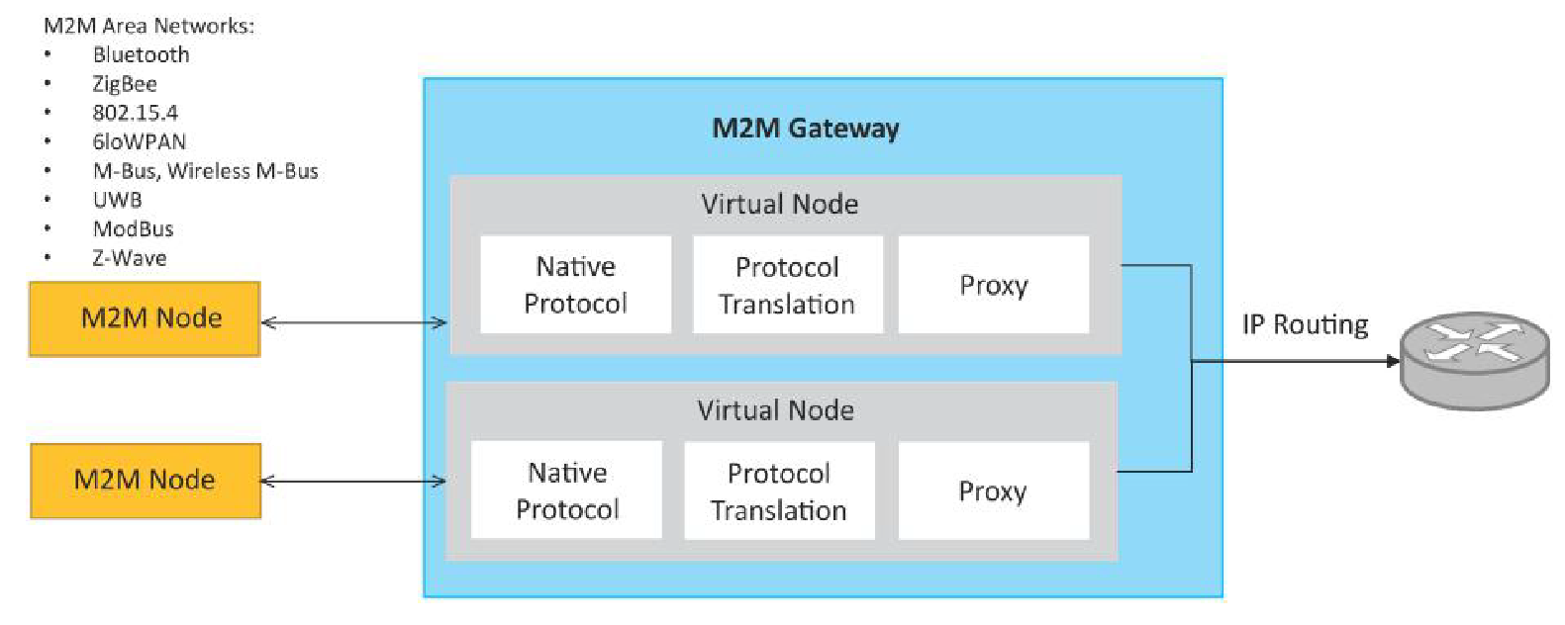
Cellular Machine-to- Machine (M2M) application networks

Slide 42
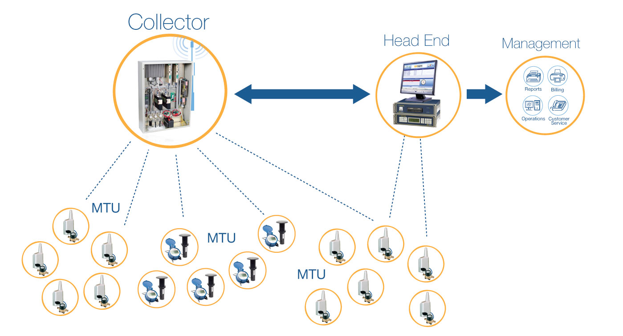
What are applications of Cellular M2M?
1.Automatic Meter Reading (AMR):
Automatic meter reading gathers diagnostic, consumption, and status data from energy or water metering devices and transfers it to the central database for billing, maintenance problems, data analysis, and troubleshooting.
Further, AMR technology falls into the category of mobile or network technologies that are based on radio frequency, telephony platforms, and power line transmissions.
Notes:
https://www.youtube.com/watch?v=k5Z3lanebEU

Slide 43
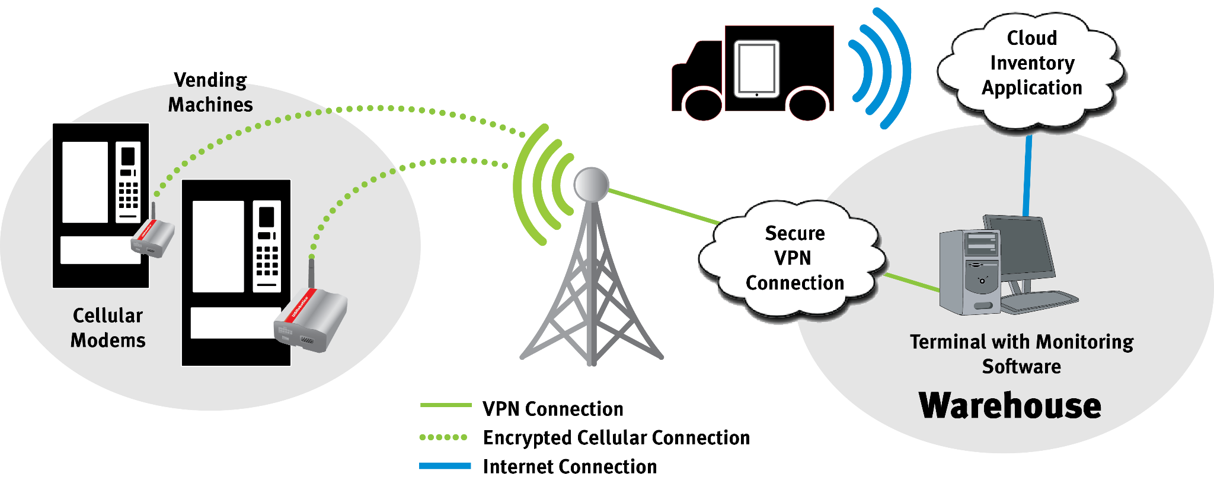
What are applications of Cellular M2M?
2. Vending Machine Monitoring:
Vending machine monitoring is capable of sales transactions, maintain stock levels & ingredient levels, send alarms during stock shortages & crimes, and sustain vending temperature.
The data acquired via vending machine monitoring is transmitted to a central host and sent through a computer system. Furthermore, communication channels for vending machines are wireless networks.
The common form of technology used is a GSM (Global System for Mobile Communications)/GPRS (General Packet Radio Service) router or a cellular GSM/GPRS modem connected via an RS-232 interface that offers connectivity to the wireless networks.
Notes:
https://www.youtube.com/watch?v=KmsUmbU_sdo

Slide 44
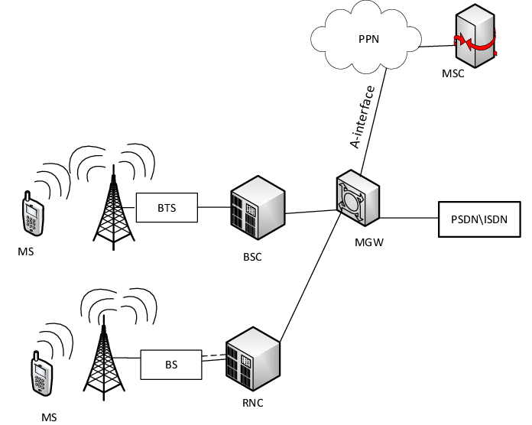
What are applications of Cellular M2M?
3. 3G or 4G Network:
Cellular M2M plays a crucial role in maintaining connectivity by customizing cellular 3G or 4G data services. Cellular M2M coupled with 3G or 4G network is better than 2G due to the following reasons:
Flexible installation: Easy to mount, durable, and built with aluminum and steel.
Backward compatibility: Software that functions with 2G cellular modems does not need replacement during upgradation to 3G or 4G networks.
Broad coverage: 3G and 4G networks provide vast cellular coverage nearly everywhere.
Easy replacement and configuration of cellular modems or gateways.

Slide 45
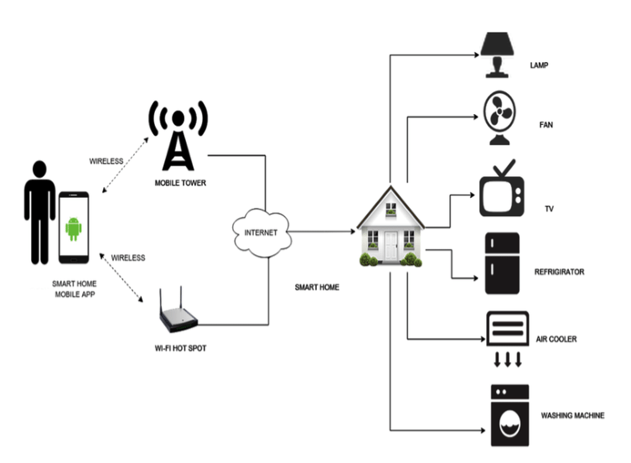
What are applications of Cellular M2M?
4. Home Appliances
Cellular M2M connectivity is estimated to boost the performance of IoT-based home appliances and take it to the next level. For example, companies such as Samsung and LG are en route to unveil smart home services and appliances to assure an advanced way of life.
Furthermore, an M2M enabled washing machine is capable of sending alerts on the owners’ smartphones or other smart devices once it’s completed with drying or washing. Also, a smart refrigerator can automatically order groceries from online e-commerce platforms such as Amazon, if its inventory is depleted.
There are numerous such examples of home appliances that can do wonders with the aid of cellular M2M connectivity and improve the quality of living for the residents.

Slide 46
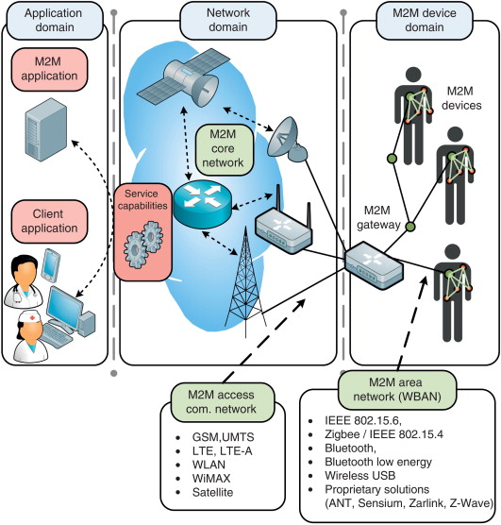
What are applications of Cellular M2M?
5.Healthcare Device Management:
The cellular M2M network has the potential to create opportunities in the healthcare sector as well. Hospitals can easily automate processes with the help of M2M technology for providing the highest level of treatments.
For example, if a patient’s vital signs drop below normal level then an M2M linked life support system can automatically offer additional care and supply oxygen until a healthcare professional arrives.
Furthermore, cellular M2M is designed to offer services at homes instead of in clinics or hospitals. For instance, devices with an M2M network can track down an elderly or frail person’s movement, detect if the person has fallen, and notify the healthcare professional about the situation.
Moreover, asset tracking is another vital feature of cellular M2M, where equipment is located quickly in hospitals during life and death situations.

Slide 47
Cellular Machine-to- Machine (M2M) application networks
Difference between IoT and M2M:
Communication Protocols:
M2M and IoT can differ in how the communication between the machines or devices happens.
M2M uses either proprietary or non-IP based communication protocols for communication within the M2M area networks.
Machines in M2M vs Things in IoT:
The "Things" in IoT refers to physical objects that have unique identifiers and can sense and communicate with their external environment (and user applications) or their internal physical states.
M2M systems, in contrast to IoT, typically have homogeneous machine types within an M2M area network.
Notes:
https://www.youtube.com/watch?v=MZsQ1WihonQ

Slide 48
Cellular Machine-to- Machine (M2M) application networks
Difference between IoT and M2M:
Hardware vs Software Emphasis:
While the emphasis of M2M is more on hardware with embedded modules, the emphasis of IoT is more on software.
Data Collection & Analysis:
M2M data is collected in point solutions and often in on-premises storage infrastructure.
In contrast to M2M, the data in IoT is collected in the cloud (can be public, private or hybrid cloud).
Applications:
M2M data is collected in point solutions and can be accessed by on-premises applications such as diagnosis applications, service management applications, and onpremisis enterprise applications.
IoT data is collected in the cloud and can be accessed by cloud applications such as analytics applications, enterprise applications, remote diagnosis and management applications, etc.

Slide 49
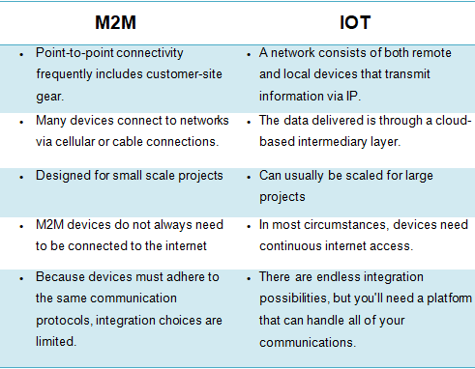
Cellular Machine-to- Machine (M2M) application networks

Slide 50
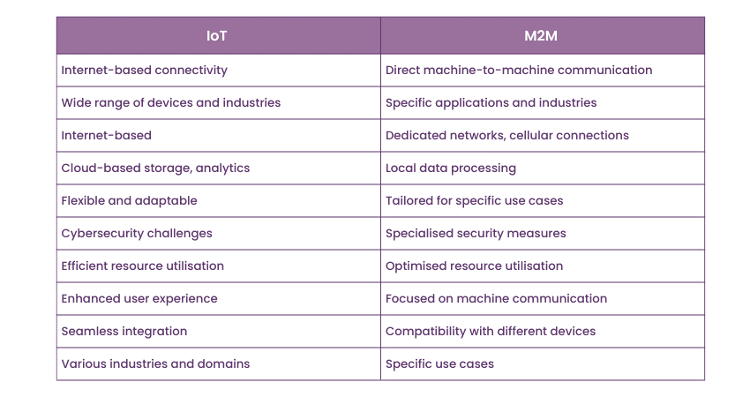
Cellular Machine-to- Machine (M2M) application networks

Slide 51
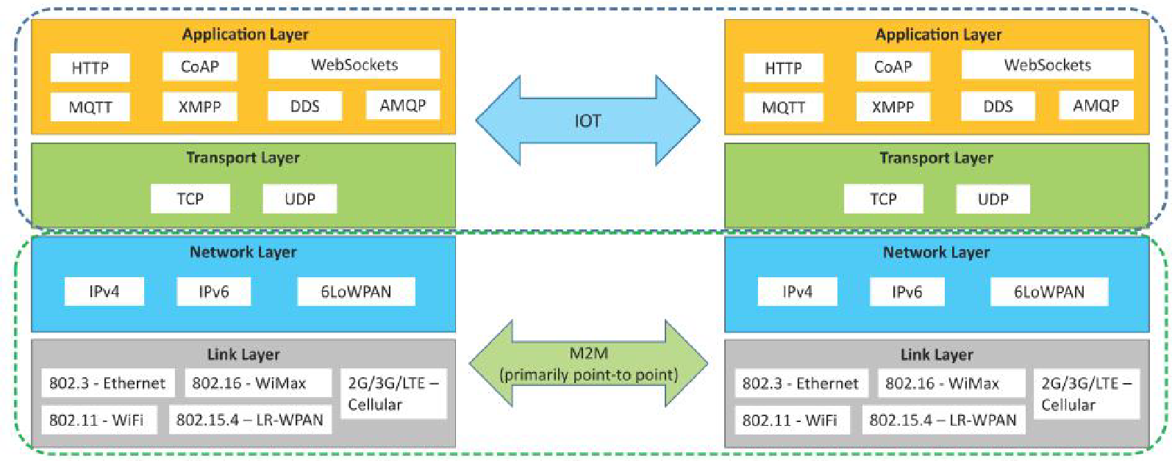
Cellular Machine-to- Machine (M2M) application networks
Communication in IoT vs M2M:

Slide 52
Cellular Machine-to- Machine (M2M) application networks
SDN
Software-Defined Networking (SDN) is a networking architecture that separates the control plane from the data plane and centralizes the network controller.
Software-based SDN controllers maintain a unified view of the network and make configuration, management and provisioning simpler.
The underlying infrastructure in SDN uses simple packet forwarding hardware as opposed to specialized hardware in conventional
Notes:
https://www.youtube.com/watch?v=J-i4D2tW1Qc

Slide 53
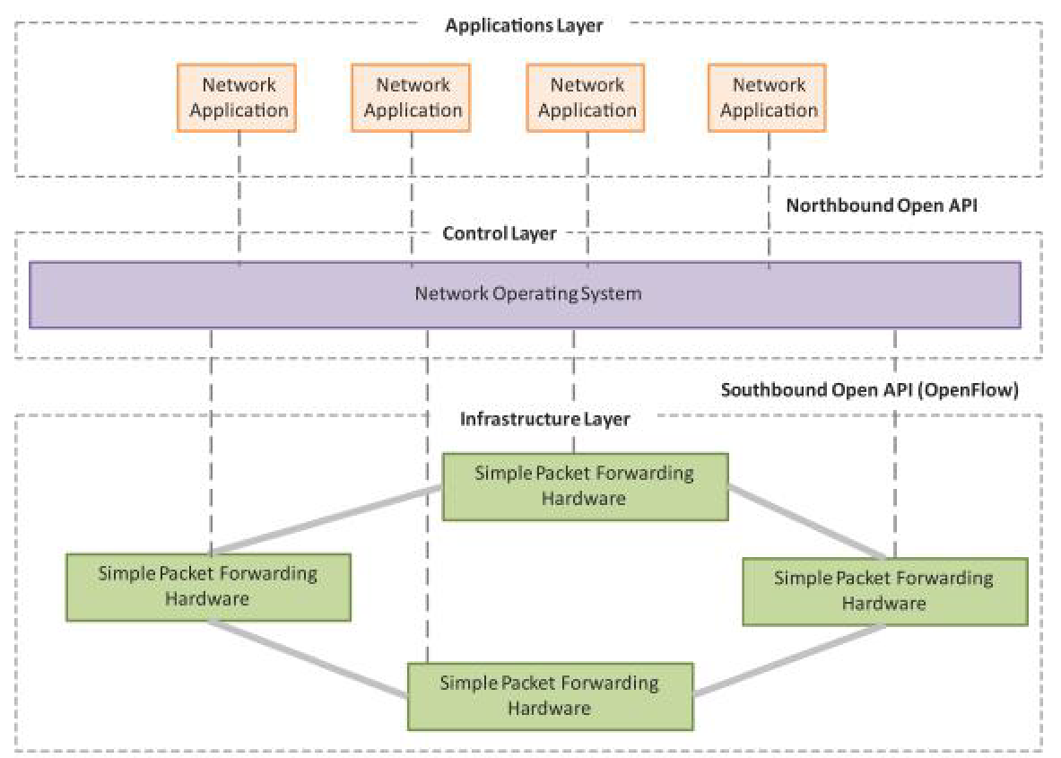
Cellular Machine-to- Machine (M2M) application networks SDN

Slide 54
Cellular Machine-to- Machine (M2M) application networks
Key elements of SDN:
Centralized Network Controller:
With decoupled control and data planes and centralized network controller, the network administrators can rapidly configure the network.
Programmable Open APIs:
SDN architecture supports programmable open APIs for interface between the SDN application and control layers (Northbound interface).
Standard Communication Interface (OpenFlow):
SDN architecture uses a standard communication interface between the control and infrastructure layers (Southbound interface).

Slide 55
Cellular Machine-to- Machine (M2M) application networks
NFV:
Network Function Virtualization (NFV) is a technology that leverages virtualization to consolidate the heterogeneous network devices onto industry standard high volume servers, switches and storage.
NFV is complementary to SDN as NFV can provide the infrastructure on which SDN can run.

Slide 56
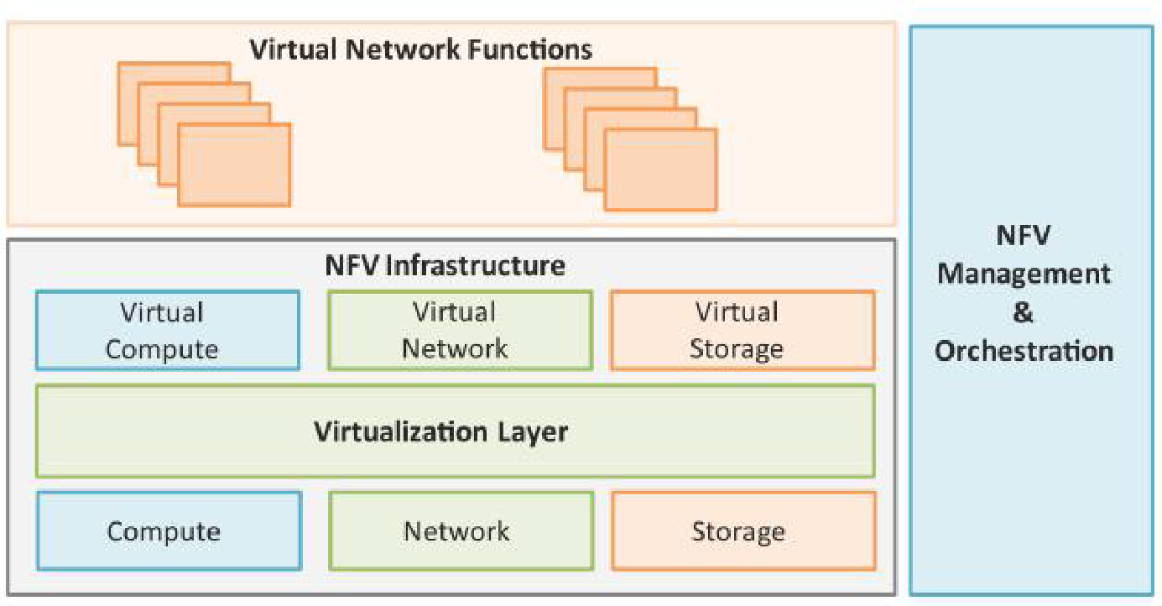
Cellular Machine-to- Machine (M2M) application networks NFV

Slide 57
Cellular Machine-to- Machine (M2M) application networks
Key elements of NFV:
Virtualized Network Function (VNF):
VNF is a software implementation of a network function which is capable of running over the NFV Infrastructure (NFVI).
NFV Infrastructure (NFVI):
NFVI includes compute, network and storage resources that are virtualized.
NFV Management :
focuses on all virtualization-specific management tasks

Slide 58
Cellular Machine-to- Machine (M2M) application networks
NFV Use Case:
NFV can be used to virtualize the Home Gateway.
The NFV infrastructure in the cloud hosts a virtualized Home Gateway.
The virtualized gateway provides private IP addresses to the devices in the home.
The virtualized gateway also connects to network services such as VoIP and IPTV.

Slide 59
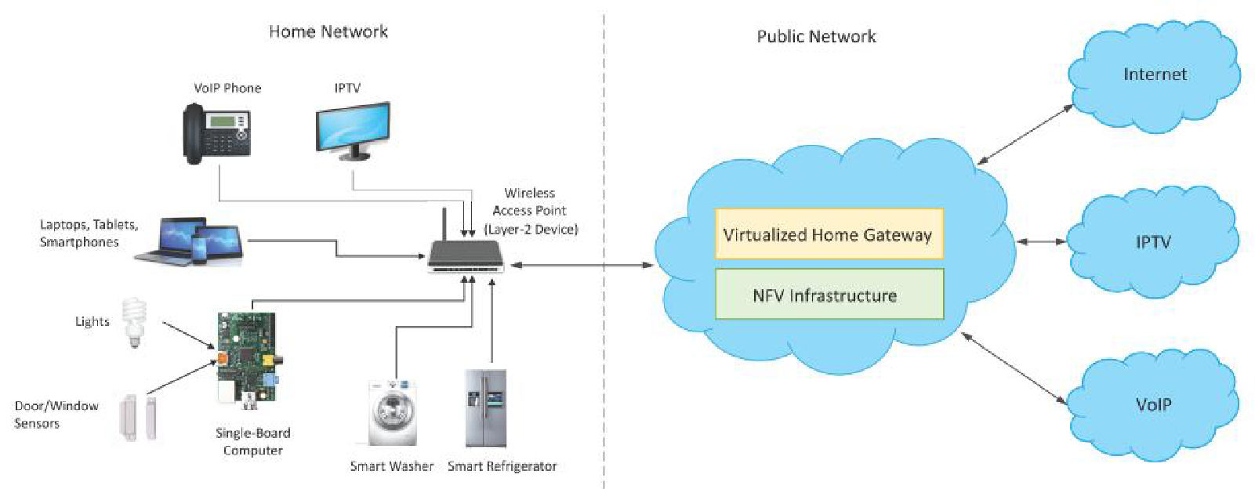
Cellular Machine-to- Machine (M2M) application networks

Slide 60
Computer Connected to Internet
Computers connect and communicate with one another over the Internet utilising the TCP/IP (Transmission Control Protocol / Internet Protocol) protocol
A computer must have a network interface card (NIC) installed in order to connect to the Internet and other computers on a network.
A network cable with the NIC on one end and a cable modem, DSL modem, router, or switch on the other can connect a computer to the Internet and other computers.
ISPs (Internet service providers):

Slide 61
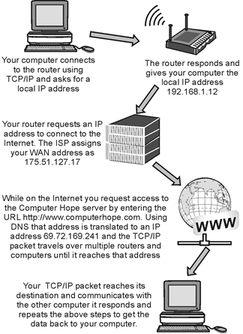
Computer Connected to Internet

Slide 62
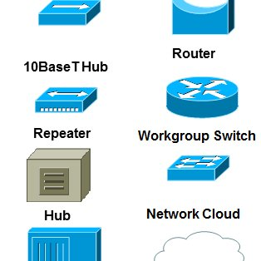
Network Devices
Components used to connect computers as well as other electrical devices together in order to share resources such as printers and fax machines.
The different devices or components used in networking include:
Repeater
Hubs
Switches
Routers
Network bridges
Gateways
Firewalls
Wireless AP (Access Points)

Slide 63
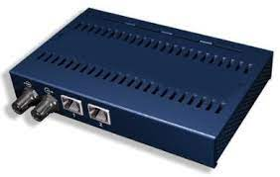
Network Devices
Repeater :
A repeater is a device works at the physical layer
Its job is to regenerate the signal across the same network before it becomes too weak or garbled,
allowing the signal to be transmitted for longer distances on the same network.
The fact that repeaters do not enhance the signal is vital to remember.
They replicate the signal bit by bit and renew it at the original strength when it becomes faint.
It's a device with two ports.

Slide 64
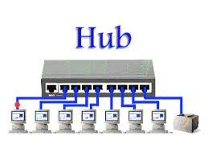
Network Devices
Hub:
A hub is a common connection point for devices in a network.
Hubs are commonly used to connect segments of a LAN.
A hub contains multiple ports.
When a packet arrives at one port, it is copied to the other ports so that all segments of the LAN can see all packets.

Slide 65
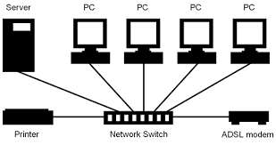
Network Devices
Switch:
A network switch (also called switching hub, bridging hub, officially MAC bridge)
is a computer networking device that connects devices together on a computer network by using packet switching to receive, process, and forward data to the destination device.

Slide 66
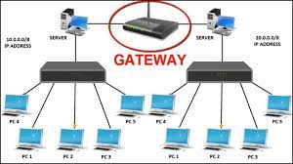
Network Devices
Gateway:
A network gateway is an internet working system capable of joining together two networks that use different base protocols.
A network gateway can be implemented completely in software, completely in hardware, or as a combination of both.
Depending on the types of protocols they support, network gateways can operate at any level of the OSI model.

Slide 67
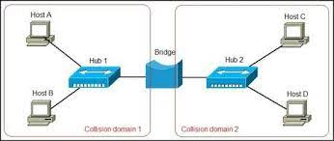
Network Devices
Bridge:
A network bridge is a computer networking device that creates a single aggregate network from multiple communication networks or network segments.
This function is called network bridging.

Slide 68
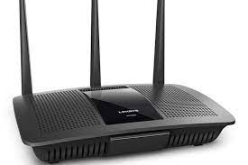
Network Devices
Router:
A router is a networking device that forwards data packets between computer networks.
Routers perform the traffic directing functions on the Internet.
A data packet is typically forwarded from one router to another router through the networks that constitute the internetwork until it reaches its destination node.

Slide 69
Device configuration and management
Need for IoT Systems Management:
Automating Configuration
Monitoring Operational & Statistical Data
Improved Reliability
System Wide Configurations
Multiple System Configurations
Retrieving & Reusing Configurations

Slide 70
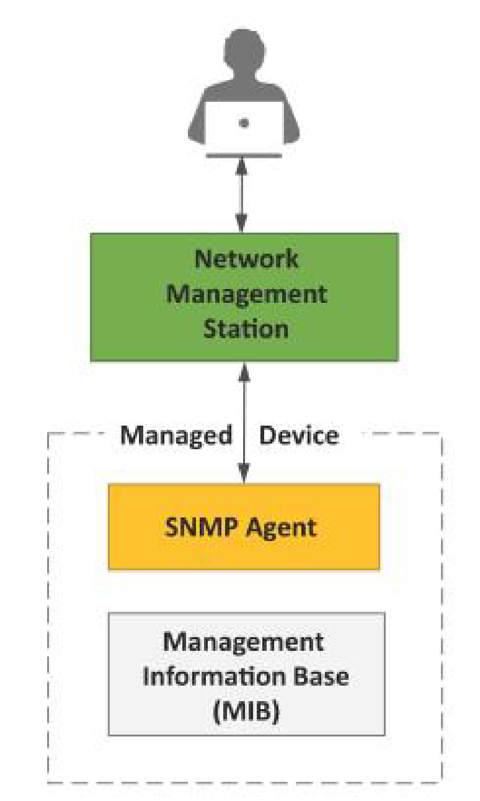
Device configuration and management
Simple Network Management Protocol (SNMP):
SNMP is a well-known and widely used network management protocol that allows monitoring and configuring network devices such as routers, switches, servers, printers, etc.
SNMP component include:
Network Management Station (NMS)
Managed Device
SNMP Agent that runs on the device
Management Information Base (MIB)

Slide 71
Device configuration and management
Limitations of SNMP:
SNMP is stateless in nature and each SNMP request contains all the information to process the request. The application needs to be intelligent to manage the device.
SNMP is a connectionless protocol which uses UDP as the transport protocol, making it unreliable as there was no support for acknowledgement of requests.
MIBs often lack writable objects without which device configuration is not possible using SNMP.
It is difficult to differentiate between configuration and state data in MIBs.
Retrieving the current configuration from a device can be difficult with SNMP.
Earlier versions of SNMP did not have strong security features.

Slide 72
Device configuration and management
Network Operator Requirements:
Ease of use
Distinction between configuration and state data
Fetch configuration and state data separately
Configuration of the network as a whole
Configuration transactions across devices
Configuration deltas
Dump and restore configurations
Configuration validation
Configuration database schemas
Comparing configurations
Role-based access control
Consistency of access control lists:
Multiple configuration sets
Support for both data-oriented and task oriented access control

Slide 73
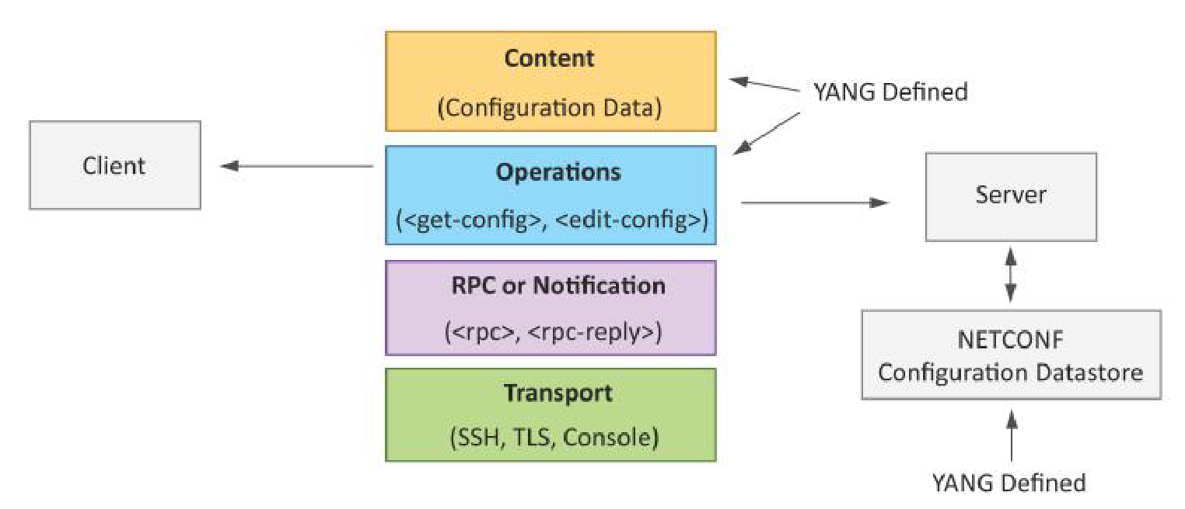
Device configuration and management
NETCONF:
Network Configuration Protocol (NETCONF) is a session-based network management protocol.
NETCONF allows retrieving state or configuration data and manipulating configuration data on network devices

Slide 74
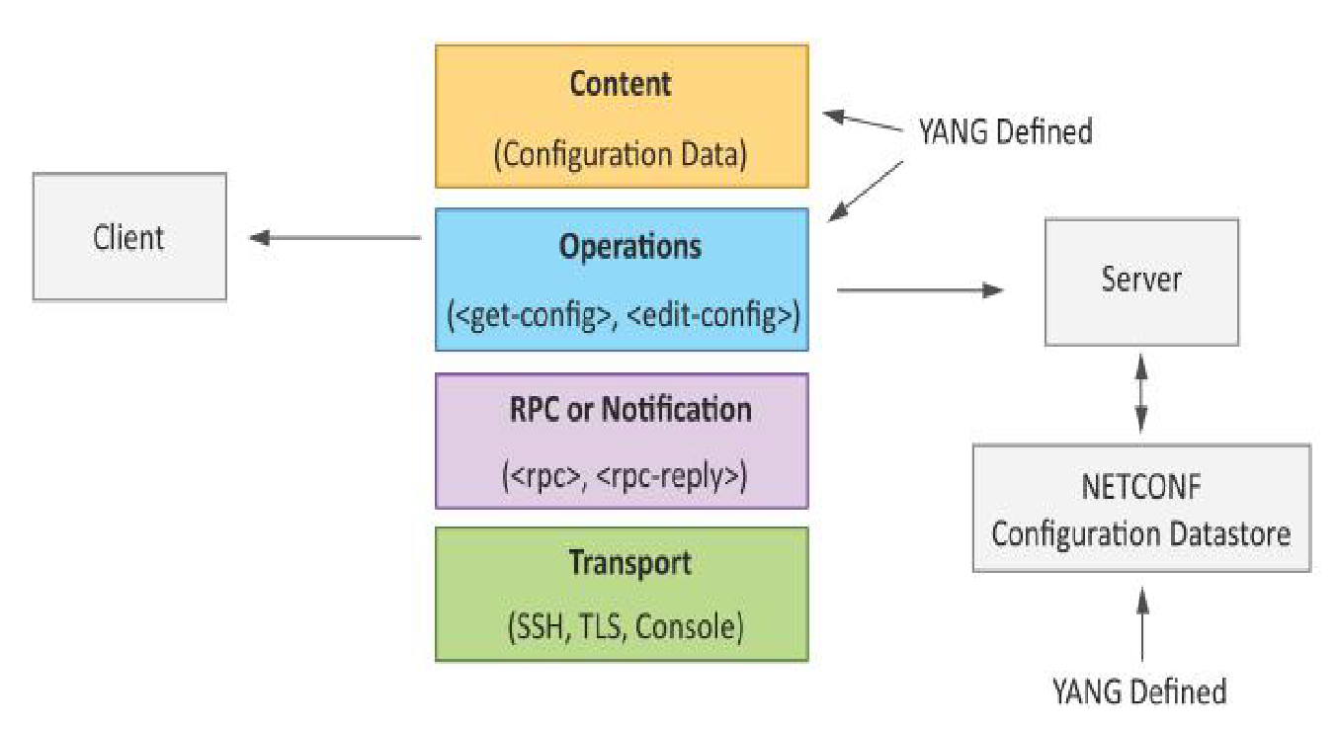
Device configuration and management
NETCONF:
NETCONF works on SSH transport protocol.
Transport layer provides end-to-end connectivity and ensure reliable delivery of messages.
NETCONF uses XML-encoded Remote Procedure Calls (RPCs) for framing request and response messages.
The RPC layer provides mechanism for encoding of RPC calls and notifications.

Slide 75
Device configuration and management
NETCONF provides various operations to retrieve and edit configuration data from network devices.
The Content Layer consists of configuration and state data which is XML-encoded.
The schema of the configuration and state data is defined in a data modeling language called YANG.
NETCONF provides a clear separation of the configuration and state data.
The configuration data resides within a NETCONF configuration data store on the server.

Slide 76
Device configuration and management
YANG:
YANG is a data modeling language used to model configuration and state data manipulated by the NETCONF protocol
YANG modules contain the definitions of the configuration data, state data, RPC calls that can be issued and the format of the notifications.
YANG modules defines the data exchanged between the NETCONF client and server.
A module comprises of a number of 'leaf' nodes which are organized into a hierarchical tree structure.
The 'leaf' nodes are specified using the 'leaf' or 'leaf-list' constructs.
Leaf nodes are organized using 'container' or 'list' constructs.
A YANG module can import definitions from other modules.
Constraints can be defined on the data nodes, e.g. allowed values.
YANG can model both configuration data and state data using the 'config' statement.

Slide 77
Exchange information in real time without human intervention
M2M:
Field Bus System and Industrial Ethernet:
Data Distribution Service (DDS):
OPC Unified Architecture:

Slide 78
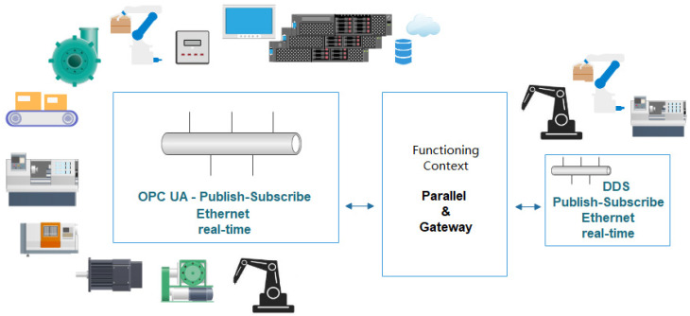
Exchange information in real time without human intervention

Slide 79
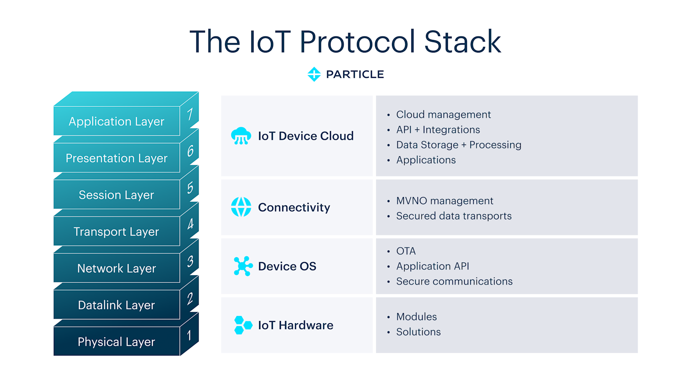

Slide 80
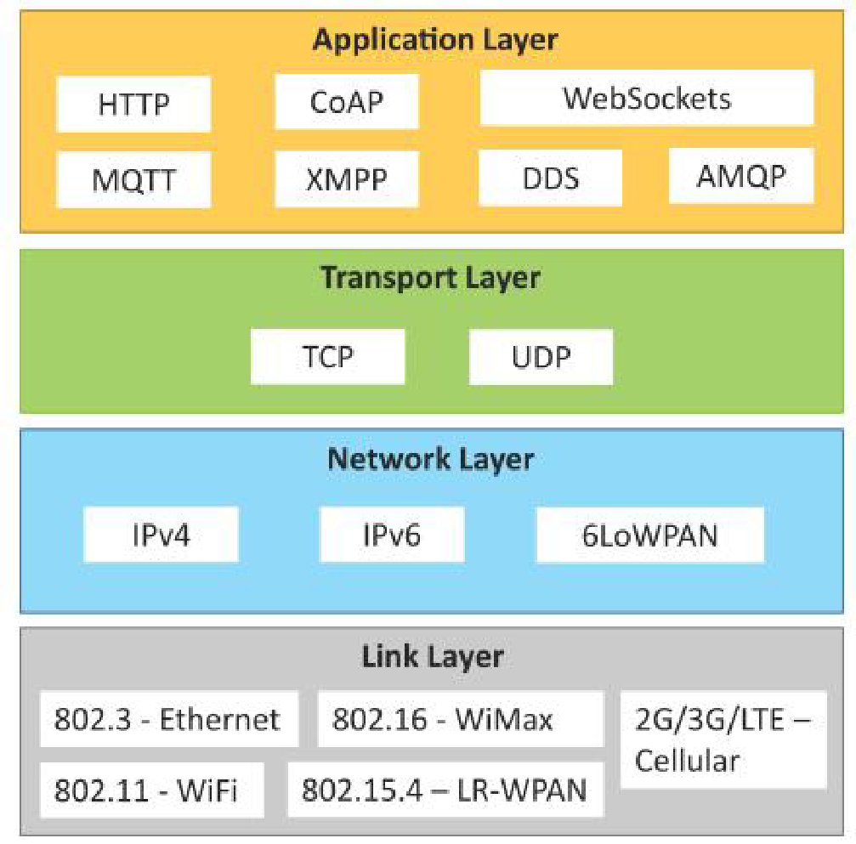
IoT Protocols
Link Layer
Network/Internet Layer
Transport Layer
Application Layer

Slide 81
IoT Protocols
Link Layer:
802.3 – Ethernet:
Used for wired medium
Basic version run at 10 Mbps
802.11 – WiFi :
Air interface between wireless client and a base station
used to create small networks and used to connect printers, conmputers, gaming consoles
802.16 – WiMax:
Worldwide Interoperability for Microwave Access
used to provide internet services such as Mobile Data and hotspots
802.15.4 – LR-WPAN:
wireless personal area network
cell phone headsets, wireless keyboards, wireless mice, printers, bar code scanners
2G/3G/4G cellular

Slide 82
IoT Protocols
Network/Internet Layer:
IPv4:
Internet Protocol version 4
IPv4 is a 32-bit binary number
IPv6 :
Internet Protocol version 6
IPv4 is a 128-bit binary number
6LoWPAN:
IPv6 over Low-Power Wireless Personal Area Networks
WSN

Slide 83
IoT Protocols
Transport Layer
TCP (Transmission Control Protocol)
TCP (Transmission Control Protocol) is one of the main protocols of the Internet protocol suite. It lies between the Application and Network Layers which are used in providing reliable delivery services. It is a connection-oriented protocol for communications that helps in the exchange of messages between different devices over a network. The Internet Protocol (IP), which establishes the technique for sending data packets between computers, works with TCP.

Slide 84
IoT Protocols
UDP (User Datagram Protocol)
User Datagram Protocol (UDP) is a Transport Layer protocol. UDP is a part of the Internet Protocol suite, referred to as the UDP/IP suite. Unlike TCP, it is an unreliable and connectionless protocol. So, there is no need to establish a connection before data transfer. The UDP helps to establish low-latency and loss-tolerating connections establish over the network. The UDP enables process-to-process communication.

Slide 85
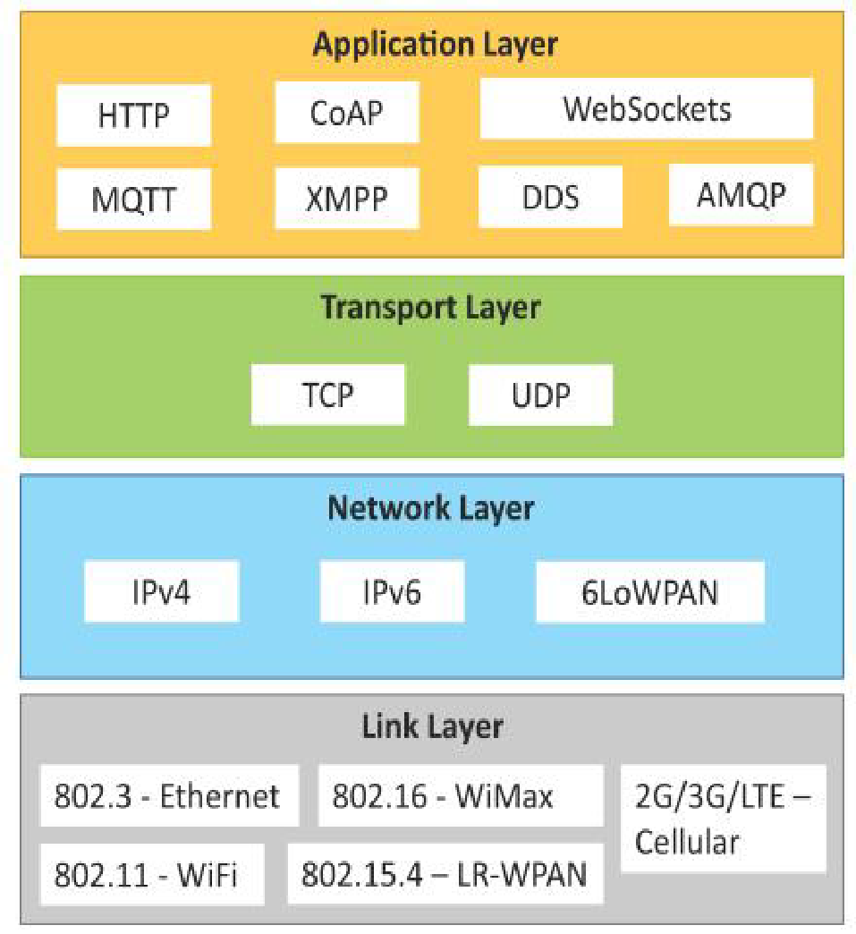
IoT Protocols
Application Layer:
HTTP (Hypertext Transfer Protocol):
transfer information between networked devices
CoAP (Constrained Application Protocol):
used for resource-constrained, low-power devices in lossy networks
WebSocket:
computer communications protocol
Provide communication channels over a single TCP connection
MQTT:
standard messaging protocol for the Internet of Things
XMPP (Extensible Messaging and Presence Protocol)

Slide 86
IoT Protocols
Application Layer:
DDS (Data Distribution Service):
is an IoT protocol developed for M2M Communication
Used for applications like
aerospace and defense,
air-traffic control,
autonomous vehicles,
medical devices,
robotics,
power generation,
simulation and testing,
smart grid management,
transportation systems, and
other applications that require real-time data exchange
AMQP (Advanced Message Queuing Protocol ):
is a secure and reliable protocol for IoT

